Slide 1
Stock Market Simulator
By: Matthew Bell
CSCI 332

Slide 2
Inspiration
Interest in investing
Recently started actively trading
Wanted to apply my profession to the financial sector

Slide 3
Design
Python Script
Stand Up DB
Create function, procedures, views, and triggers
Parse CSV for Initial Data
Insert Administrators
Apache tomcat
Web Server
Java Servlet & JSP
Web application
JDBC
Alpha Vantage API
To obtain ticker information

Slide 4
Normalization
4th Normal Form
All tables depend on each other
No multivalue dependencies
All attributes can be functionally determined with primary key

Slide 5
Integrity Enforcement
Extensive use of foreign keys
10 total
Enforcement of NOT NULL on values that ought not to be NULL
Default accountBalance of 0.0
Minimized redundancy when possible
CHECK LIKE constraint used but not enforced by InnoDB
Can be implemented with a trigger

Slide 6
Isolation Level
Repeatable Read
No Reason to change this

Slide 7
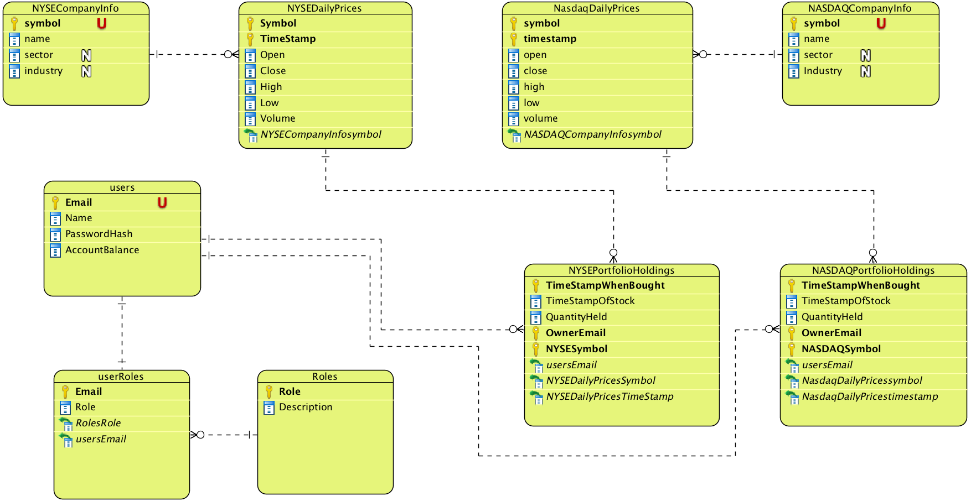
ER Diagram

Slide 8
Tables
Users
UserRoles
Roles
NasdaqCompanyInfo
NasdaqPricesByTheMinute
NasdaqPortfolioHoldings
NyseCompanyInfo
NysePricesByTheMinute
NysePortfolioHoldings

Slide 9
Views
portfolioHoldingsView
A UNION of Nasdaq and NysePortfolioHoldings
companyInfoView
A Union of Nasdaq and NyseCompanyInfo
stockPricesByTheMinute
A union of Nasdaq and NysePricesByTheMinute
userHoldings
A report of portfolioHoldingsView that includes price paid per share and total cost of the shares
simpleUserHoldings
A report of userHoldings that combines stocks with the same symbol and owner
Averages price paid per share

Slide 10
Functions and Procedures
getPrice(timme TIMESTAMP,givenSymbol VARCHAR(255))RETURNS decimal(14,2);
Gets historical closing price given a symbol and timestamp
symbolInNasdaq (givenSymbol VARCHAR(255)) RETURNS BOOLEAN
Returns if givenSymbol exists in NasdaqCompanyInfo
symbolInNyse (givenSymbol VARCHAR(255)) RETURNS BOOLEAN
Returns if givenSymbol exists in NyseCompanyInfo
getNumberOfStockHeld (givenSymbol VARCHAR(255),email VARCHAR(255)) RETURNS INT
Gets the number of shares of givenSymbol owned by email
sellStock(email VARCHAR(255),symbolToSell VARCHAR(16),sharesToSell INT)
Issue:Stock holdings can be in multiple entries
This procedure:
Determines which database needs to be updated
Deletes portfolio entries until entry has more shares than is trying to be sold
Updates the last entry
Updates User’s accountBalance to include revenue from sale

Slide 11
Trigger(s)
AddUserRoleTrigger
Upon insert into Users
inserts user’s email into UserRoles Table with role = ‘user’
This trigger enforces that no new users can become admin
Future Triggers
Email check constraint on Insert , Update
Ensure email is valid
since InnoDB does not enforce CHECK
accountBalance check constraint on Insert, Update
Ensure account balance is never negative
Dead Demo |
\/

Slide 12
Dead Demo (Sign Up)

Slide 13
Dead Demo (buy/sell stock)

Slide 14
Dead Demo(Admin role)

Slide 15
TODO
Bootstrap
Allow users to edit their Name/Delete their account
Allow admin to remove Users
Allow admin to view all tables
Implement Charts
Optimize API call by checking if lastest price is in the DB already
Application is currently calling api ( 2-20 seconds) every time it checks for latest price
Create another table to hold portfolioHoldings on Delete
Keeps a clear record of all stock transactions

